Slide 1
Transfer Learning
Ahmad Jazlan
Department of Mechatronics Engineering
International Islamic University Malaysia

Slide 2
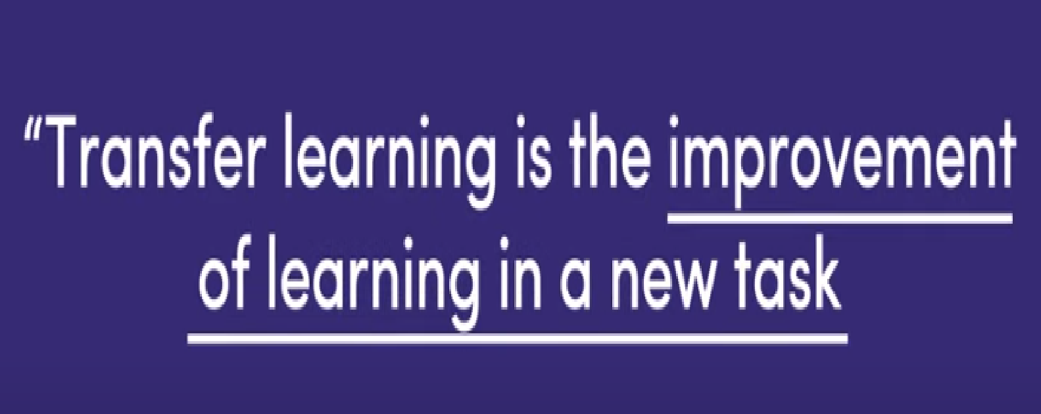

Slide 3
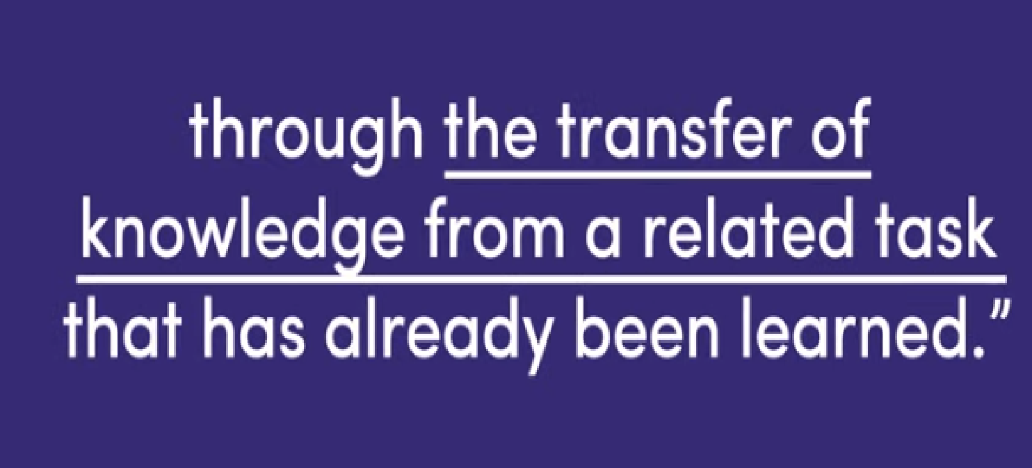

Slide 4


Slide 5


Slide 6
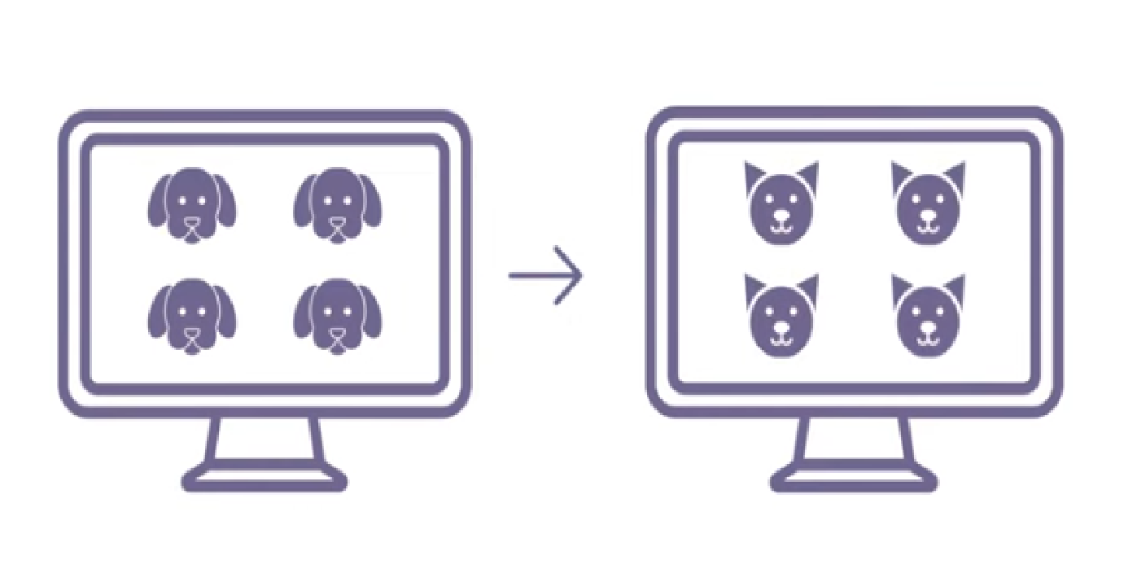
We are not ‘starting from zero’ with transfer learning

Slide 7
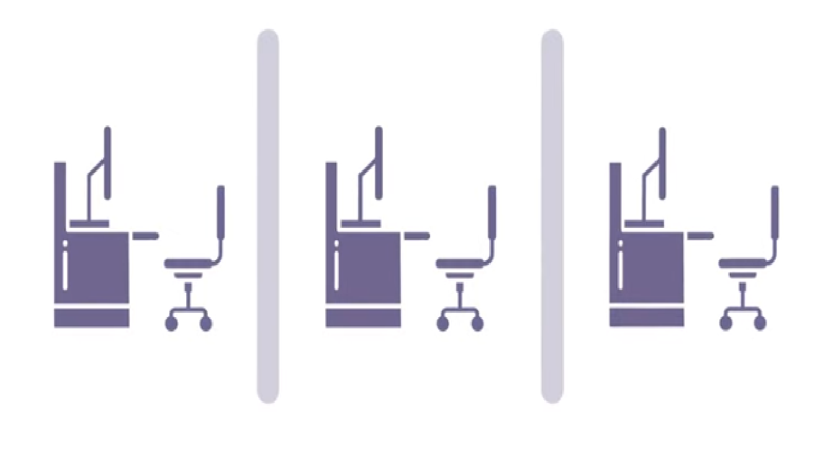
Traditional Machine Learning - Learning in isolation

Slide 8
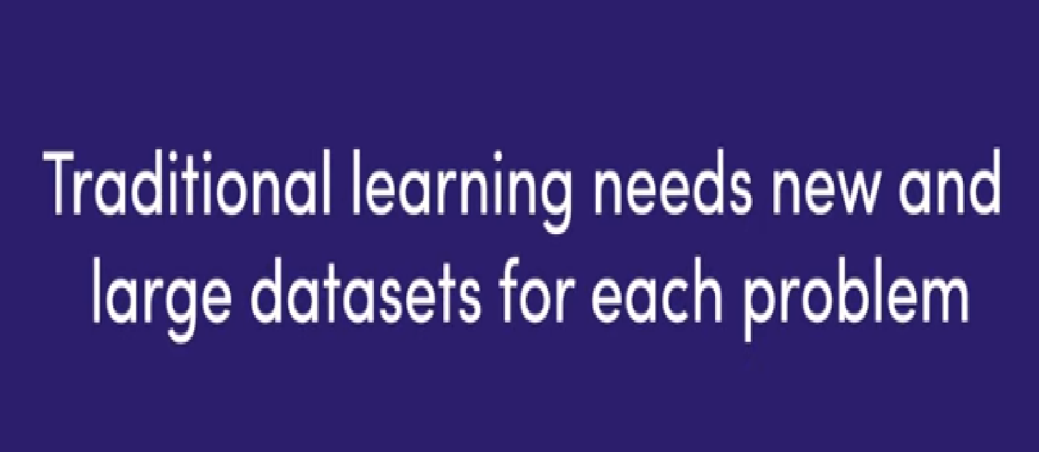

Slide 9
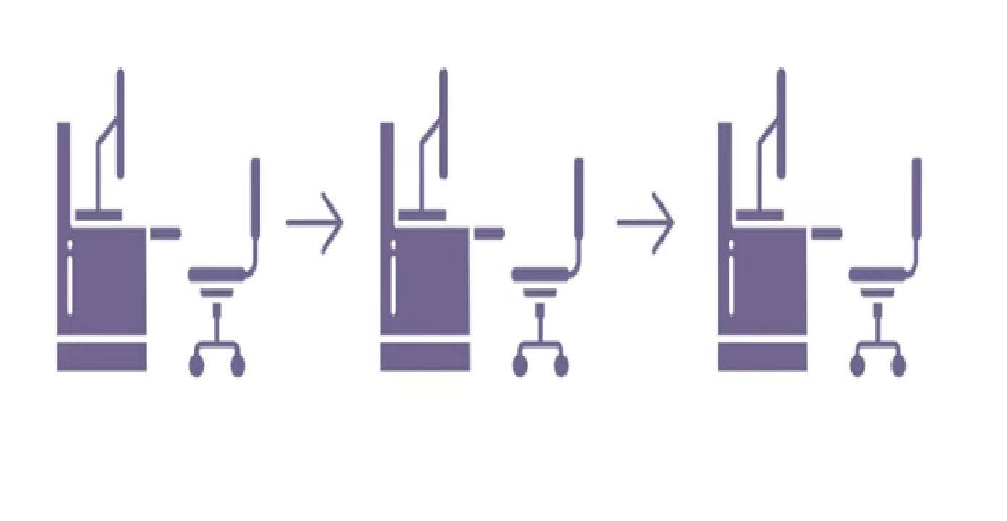

Slide 10
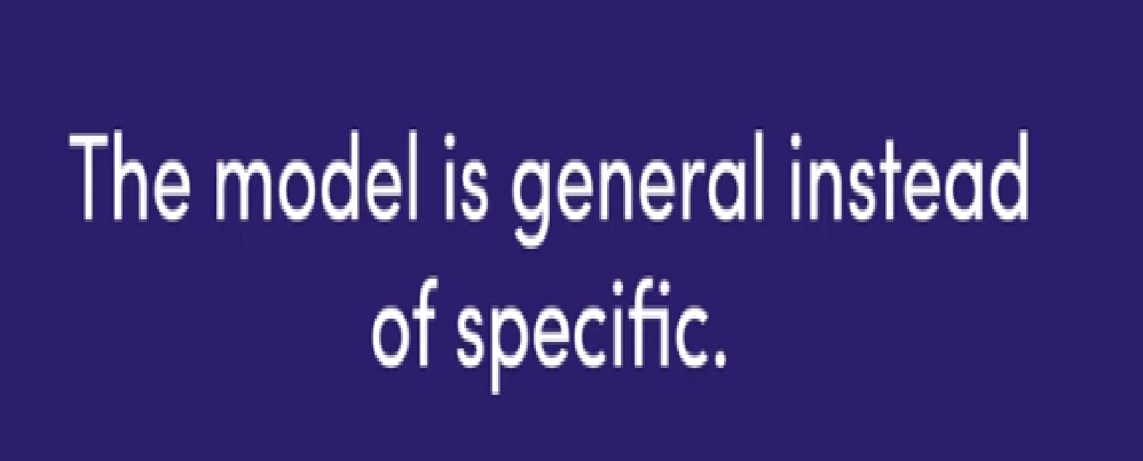

Slide 11


Slide 12
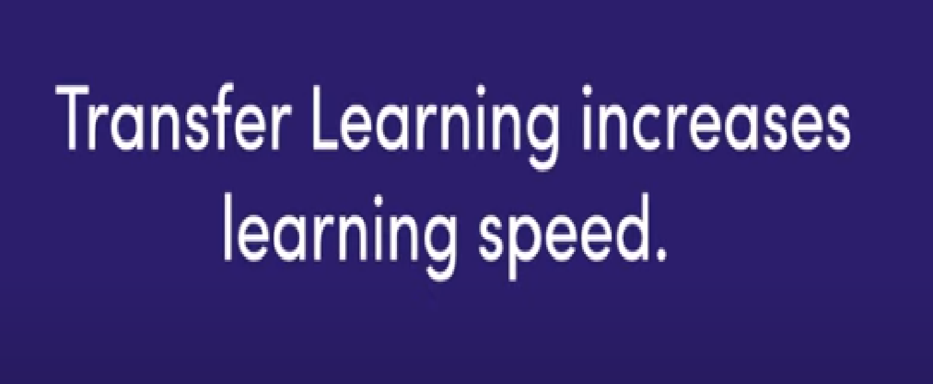

Slide 13
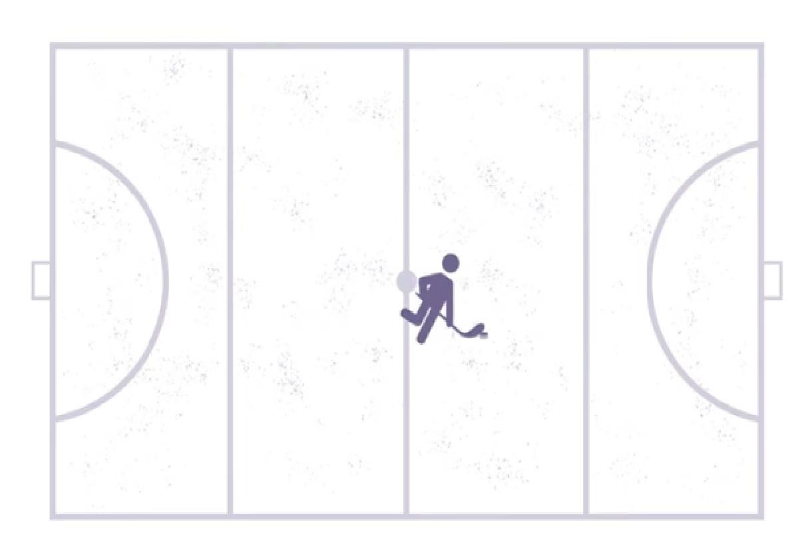

Slide 14
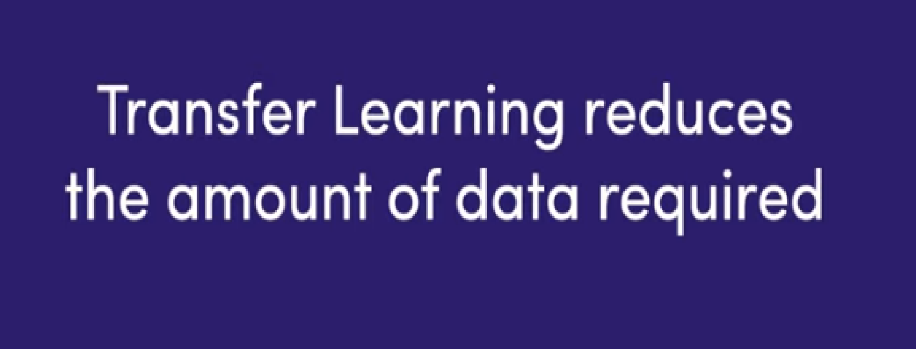

Slide 15
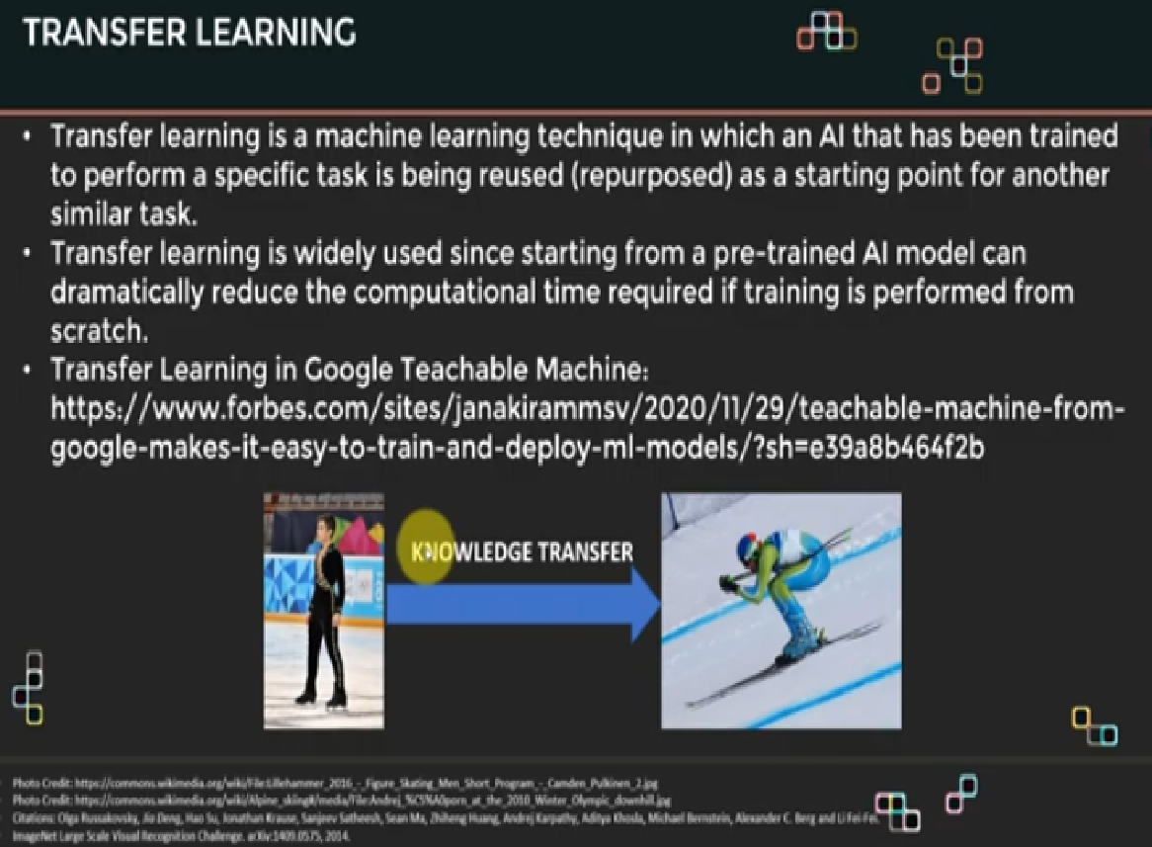
Knowledge Transfer

Slide 16
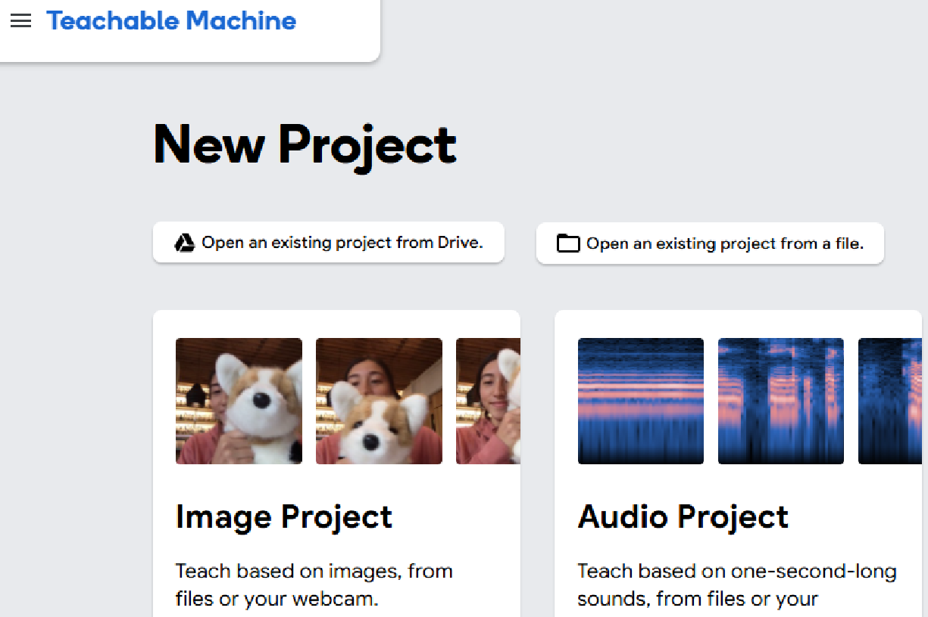
Google Teachable Machine

Slide 17
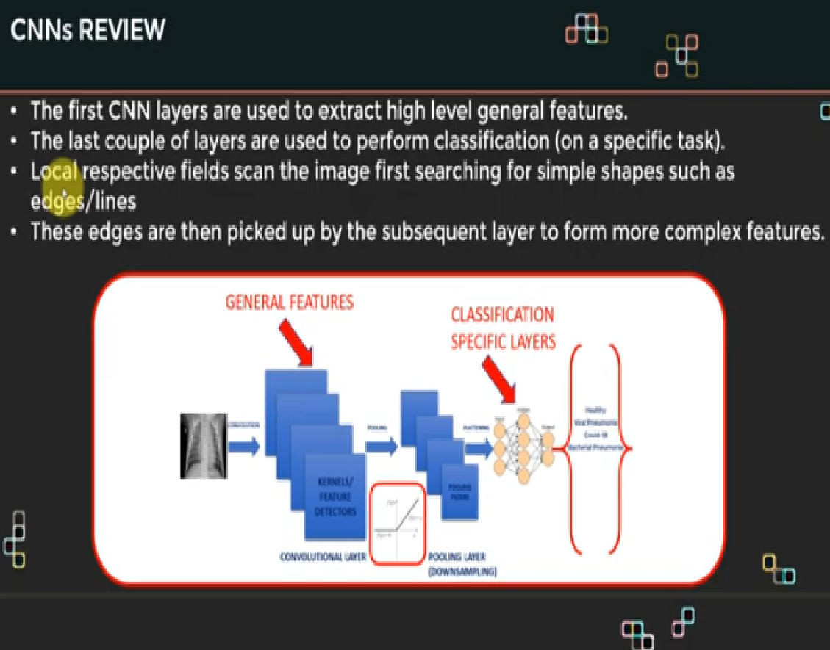

Slide 18
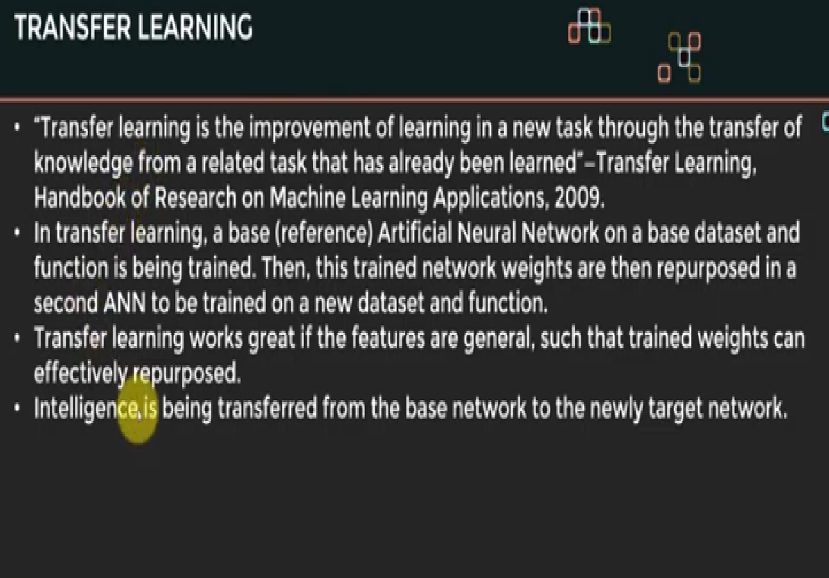

Slide 19
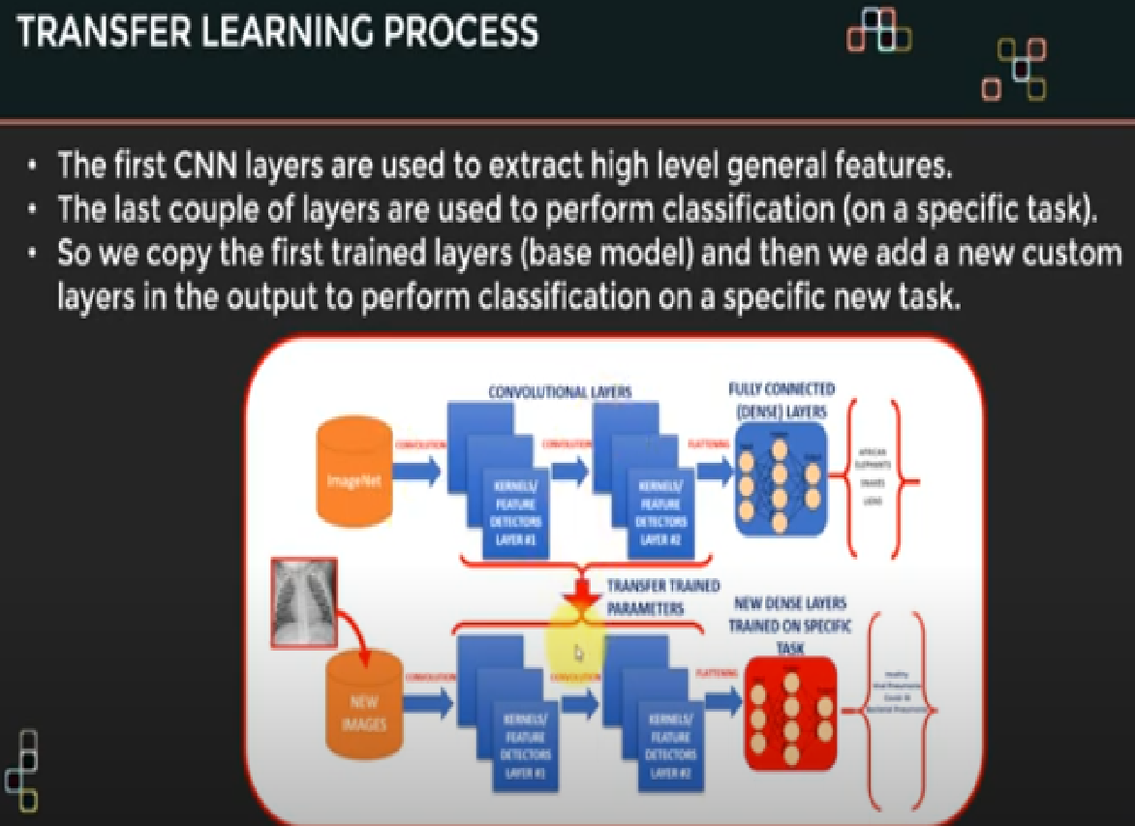

Slide 20
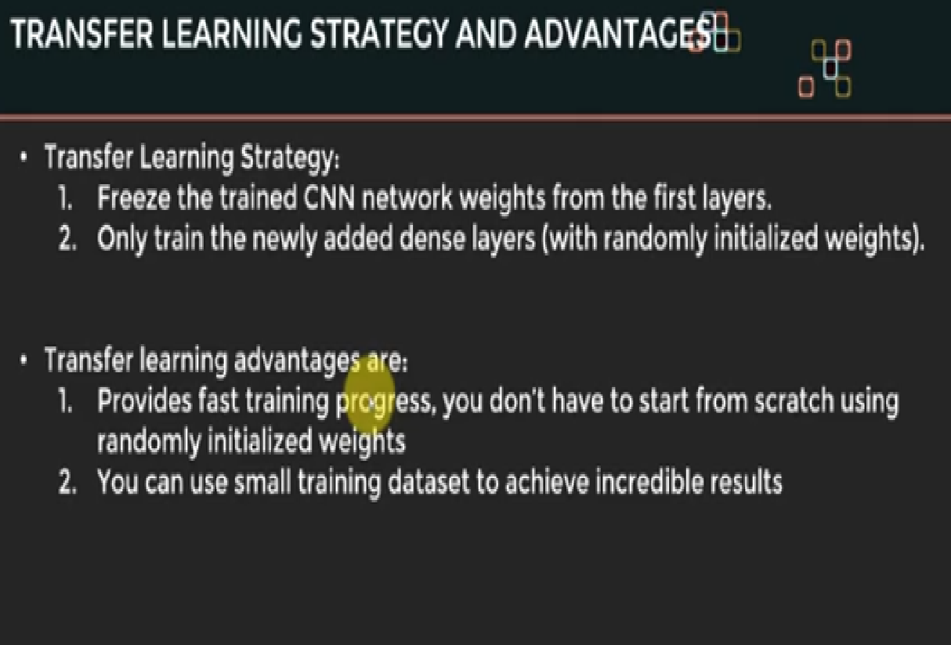

Slide 21
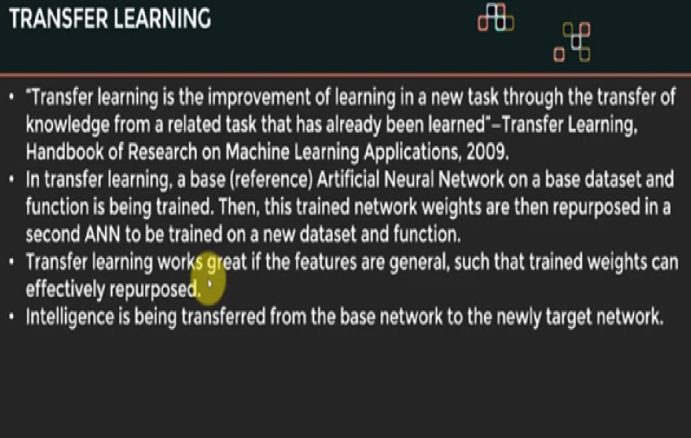

Slide 22
Human Intelligence Vs AI
What Happens to a Radiologists Knowledge when he dies?
Knowledge captured in books, videos only?
Capturing Intelligence

Slide 23
